Slide 1

Affordability 101
Awareness & Concepts
Lockheed Martin Missiles and Fire Control
E&T Affordability
2018

Slide 2
Affordability 101 Sections
Introduction “Why am I here?”
Affordability Context & Drivers “Why should I care?”
Affordability, Cost, & Value “What does it mean?”
Exercise– Build a UGV “How is this relevant?”
Design to Cost & Value Optimization “How do I do it?”
Conclusion & Review “What do I do next?”

Slide 3
Affordability 101 Course Objectives
By the end of this course, you should be able to:
Outline MFC Affordability Culture Optimization Efforts
Describe the Drivers for Increased Emphasis on Affordability
Explain the relationship between Customer Value, Solution Performance and Cost
Summarize the Differences between Designing Value In & Taking Cost Out and Which One is Better
Describe how Position To Win and Design To Cost shapes the product value and cost
Identify the Next Steps in Your Commitment to Affordability
Focus of Course is the Development of Affordable Solutions

Slide 4
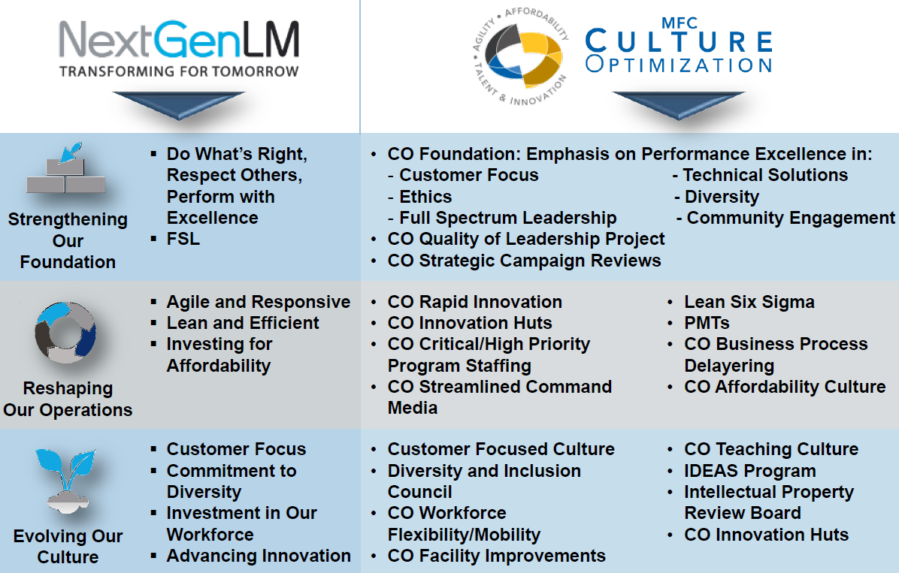
MFC’s Culture Optimization Initiative Supports NextGenLM

Slide 5
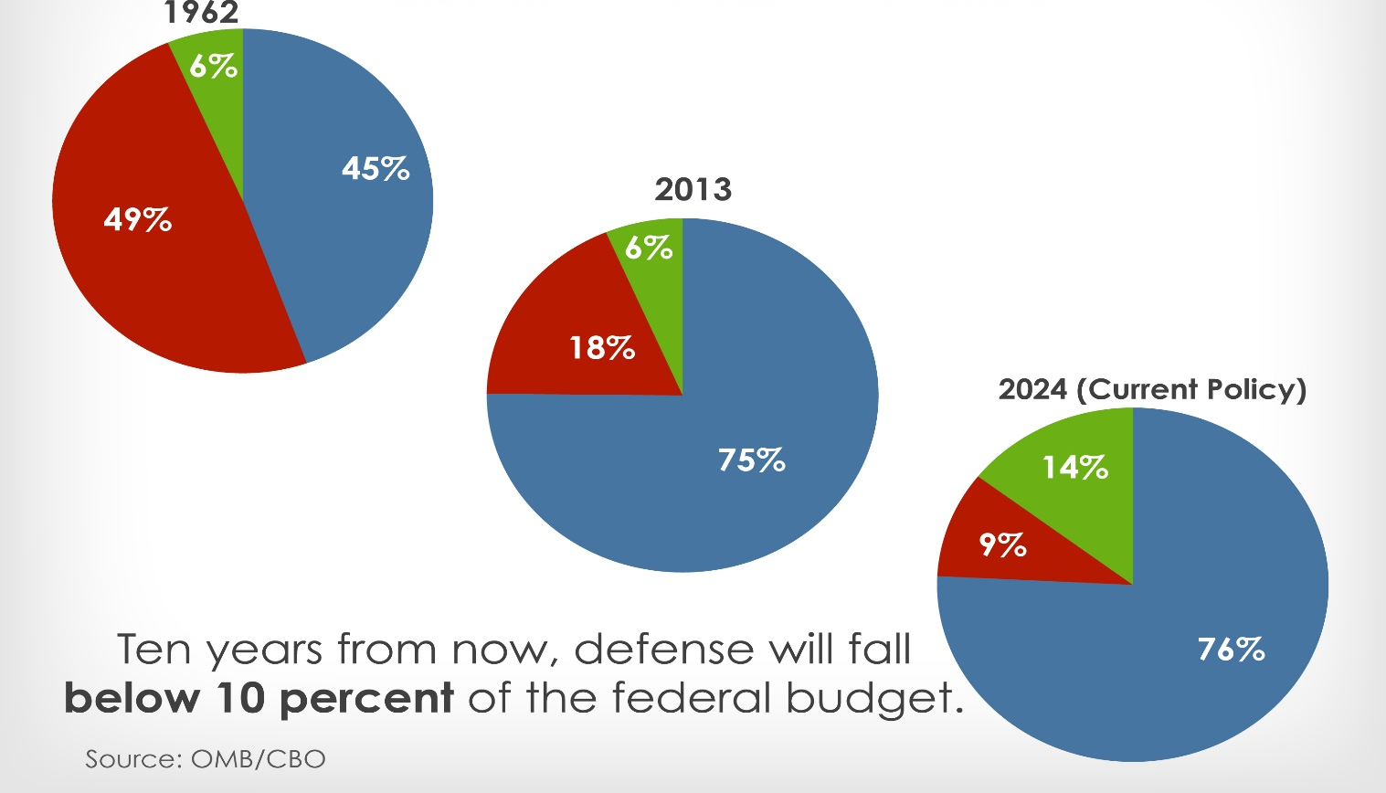


DoD Affordability Context & Drivers
“Why Should I Care?”
Defense
Non-Defense
Net Interest

Slide 6
Future Years Defense Program 2017
FY2016$B
2017
2021
Source: Congressional Budget Office Analysis of the Obama Administration’s Final Future Years Defense Program
https://www.cbo.gov/system/files/115th-congress-2017-2018/reports/52450-fydp.pdf
DoD budget Increases are driven primarily by Operations and Support

Slide 7
Changes in Defense Acquisition Environment
Environmental Driver | Impact on Defense Industry
Poor Performance of the Defense Acquisition System | Risk Aversion in Development Programs Hard Budget Caps with Consequences
Changing National Priorities & Increased Operational Costs | Lower budgets for R&D & Procurement
Technology Leadership Shift from Military to Commercial | Commoditization of High Technology Non-Developmental Solutions
Decreasing Number of Major Development Programs | Reduced Development Opportunities Increased Competition & Protests
DOD Focus on Increasing Competition | Leveling of Technical Requirements Long-term Franchises in Jeopardy
Why
How
Customer is Increasing Focus on Short- & Long- Term Cost of Solutions

Slide 8
DoD Affordability Caps
Ford-class Carrier Descoping
Estimate exceeded cost cap
Deferred ~$100M in work until after delivery
Postponed $200M+ in near-term upgrades
Operational Impacts:
  Lower manning levels
  Reduced communications capability
  Reduced self-defense & survivability
  Delayed F-35 compatibility until 2027
All Major Defense Acquisition Programs to be issued cost caps at Milestone B (~PDR)
  Per-unit Costs
  Sustainment Costs
Govt PM’s annually report cost reduction & descoping options
Programs that breach caps have three options:
  Cancel program
  Move funds from other programs
  Remove scope from program
Source: GAO (http://www.gao.gov/assets/670/667092.pdf)
DoD is Trading Operational Capability & System Performance to Control Costs

Slide 9
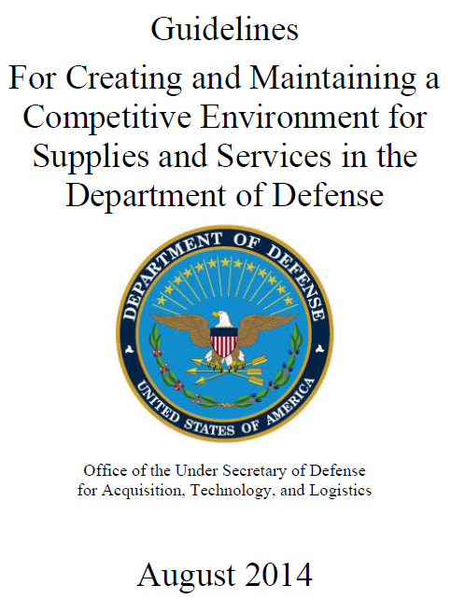
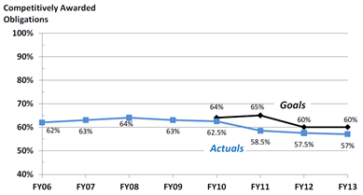
DoD Mandate for Increased Competition
Restrictions on Sole-Source
Split Buys
Commercial Derivatives
Component Break-out
Acquiring Technical Data Packages
Funding Second-Source Development
DoD is holding services accountable for competition levels
SOURCE: 2014 Report on the Performance of the Defense Acquisition System (http://bbp.dau.mil/docs/Performance-of-Defense-Acquisition-System-2014.pdf)
Desire for Competition Leads to “Leveling” of Performance Requirements

Slide 10
Knowledge Check
What are the primary drivers for the Government’s focus on Affordability?
  They Have To: Increasing Cost of Operations Coupled with Budget Pressures
  They Can: Increasing sources of relevant high technology
What is the Department of Defense Doing to Improve Affordability?
  Executing Cost Control Initiatives (e.g. Better Buying Power)
  Increasing Competition including
    Commercial Options
    Second Sourcing
  Balancing Technical Performance / Capability with Cost
Why is Affordability Important to our Business?
  Poor Affordability Puts us at a Huge Competitive Disadvantage
  Unaffordable Systems Never Make it to the Warfighters Regardless of Performance

Slide 11
LM Affordability Context – Cost & Value
“What does it mean?”

Slide 12


Characteristics of Affordability
Affordability is defined by the Customer, not us
  Evaluation is subject to Customer organization & culture
Affordability changes throughout the lifecycle
driven largely by external factors
  Operational environment
  Competitive environment
  Budget environment
Affordability is complex, but must be quantified
  Customer decision point
  Customer assessment of our solution
$
Solution is Affordable when Value > Cost from the Customer’s Perspective
Notes:
There is no single definition of affordability, but there are some general characteristics that can help you determine what it means for your program
#1 is to recognize that it is defined by YOUR CUSTOMER, not by us.
Then we must accept that it is not static. Development efforts that don’t make it to production or execution becaouse of unit costs or production runs that are truncated because the solution is not sustainable in the field do not serv our Customers or shareholders.
The trickiest part is when challenges arise due to external factors. Such as when changes in how they use our products and services change the value & cost equation.
Or when an alternative solution shows up that delivers similar capability at a lower cost
And of course, sometimes the Customer just runs out of money
Therefore, it is critical that we quantify what we mean when we say “Affordable” for a particular program.
It needs to be forward looking (that means no CPI/SPI) and it needs to be business relevant.
You will usually want to define it around the Customer’s assessment of our solution at a critical decision point such as a sole-source justification or RFP.
Putting it into a numerical context and working it at all levels allows us to be Transparent, Accountable and Results Driven when dealing with what can be a nebulous concept, which are qualities that well run programs strive for.

Slide 13
Characteristics of Affordability
Affordability is defined by the Customer
  Evaluation is Subject to Customer Organization & Culture
Affordability Changes throughout the Lifecycle
  What is Affordable to Produce Might Not be Affordable to Maintain
Affordability of the Program Impacted by External Factors
  Operational Environment
  Competitive Environment
  Budget Environment
Affordability is a Complex Concept, but Can Be Quantified
  Customer Decision Point
  Evaluation Criteria
  Assessment of our Solution
Solution is Affordable when Value > Cost from the Customer’s Perspective
Notes:
We are frequently asked in the Affordability Office to define “affordability”. Therefore I wanted to address this 1st. If I asked each of you and a number of our USG Customers, I believe I would hear many different definitions. LM has defined it as follows……
We recently asked Rear Admiral Eastburg of NAVAIR (our Customer that purchases our F-35s) at our Affordability Offsite and his definitions mirrored what you see here. He also communicated that WE must be Transparent, Accountable and Results Driven
And in a recent Customer Perception Survey of 248 Federal Civilians, DoD Personnel, and Congressional Staff, the Single Most Important Factor of our Customers was “to provide affordable solutions that deliver high value” AND was equal to “Adherence to Ethical Standards”.
Other factors included: past performance, technology innovation, nurture talent, good corporate citizen, global security thought leader.
100 Federal Civilians (Broad range of targeted agencies (18 total), Majority GS-13+, including SES)
101 DoD Personnel (Mix of military services; Generally Senior and Flag Officers)
47 Congressional Staff (High level (such as Directors and Press Secretaries; Representing House, Senate and Committee Members)

Slide 14
Lifecycle Cost Elements
Life Cycle Cost (LCC)
Research, Development, Test & Evaluation
Procurement
Operating & Support (O&S)
Disposal
Design and Development
Integration, Verification, & Validation
Prepare for Full Rate Production
Platform Integration
Prototypes & Development Models
Material
Fabrication
Verification
Delivery
Production Support
Production Tooling
Spares
Unit-Level Manpower
Transportation
Training
Operating Materiel
Energy
SW Maintenance & Modifications
Repairs & Maintenance
Decommission
Storage
Cost to Customer is more than Development & Production Costs

Slide 15
Program Life Cycle Cost Distributions
O&S bills are a major cause of the current budget challenges
Ratios of cost elements vary by system type
Data from: OSD/CAPE O&S Cost-Estimating Guide dtd Mar 2014

Slide 16
The Cost of a System is “Designed In”
When is the Cost Designed In? Here’s a prototypical example:
  40% Gleam in the eye of a few visionaries
  65% Milestone 0: Material Solution Sought
  75% Contract Award for Tech Development
  85% Contract Award for Engineering Manufacturing Development
  93% Contract Award for Full Rate Production
Design Cost vs. Expenditures
Cumulative Cost by Type
TMRR
LRIP
TMRR
LRIP
11,000
Pre A
EMD
Production
Service
Ramp Down
11,000
Pre A
EMD
Production
Service
Ramp Down
10,000
10,000
9,000
9,000
8,000
8,000
7,000
7,000
Total Program Cost $M
Total Program Cost $M
6,000
6,000
5,000
5,000
4,000
4,000
3,000
3,000
Cum O&S $M by Yr
2,000
2,000
Cum Prod. $M by Yr
1,000
Committed LCC Cost
1,000
Cum NRE $M by Yr
-
Taxpayer's Expense
-
-4
-2
0
2
4
6
8
10
12
14
16
18
20
22
24
26
28
30
32
34
36
38
40
-4
-2
0
2
4
6
8
10
12
14
16
18
20
22
24
26
28
30
32
34
36
38
40
Program Year
Program Year

Slide 17
Implications of Designing In Cost
TMRR
When do we realize the greatest STOCKHOLDER returns?
Pre MS A
EMD
Production
Service
Ramp Down
11
10
Production
9
When is our highest profit margin?
8
Service
7
Total Program Cost $B
When is our lowest profit margin?
6
Pre MS A
5
4
When do we have the best opportunity to win follow on work?
3
2
Committed LCC Cost
Taxpayer's Expense
Prod
Service
1
When would we normally add International sales?
-
-4
-2
0
2
4
6
8
10
12
14
16
18
20
22
24
26
28
30
32
34
36
38
40
Program Year
Prod
Service
When is the system’s performance “designed in”?
When is our highest technical risk?
TMRR
EMD
TMRR
Cost and Performance Are ‘Designed In’ Together
When is the DoD most likely to cancel the program?
EMD

Slide 18
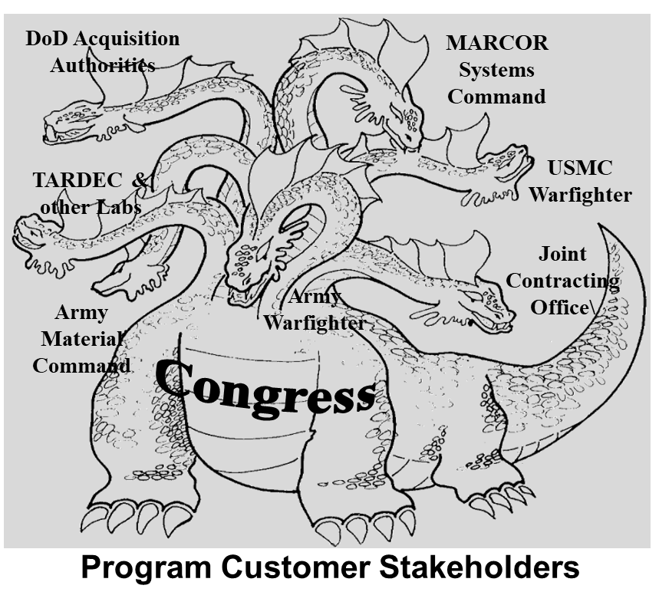
Who Determines “Value”?
Value is Often Viewed as the Performance-to-Cost Ratio
Cost is Hard to Estimate but Objectively Based
Performance Estimates are both More Complex and More Subjective
DoD Programs have Multiple Stakeholders --Seriously Complicating Who Defines “Value”
Achieving “Affordability” Requires Aligning Customer Value & Cost
Influence of Customer Segments Change over Life of Program
Notes:
For Lockheed Martin QCV is complicated by the fact that there is never one customer to satisfy. Worse yet, it is frequently complicated by the fact that engineering teams, project managers and even business leaders lose sight of the fact that there is more than one customer to satisfy.
This image of the multi-headed hydra illustrates the problem. Let’s consider an easy example. We won a DARPA contract to pursue a Reconnaissance, Surveillance and Target Acquisition Vehicle (RSTV) for the Marine Corps. To move from Phase I (basically view graphs and studies) to Phase 2, we needed to satisfy DARPA. But to eventually move from Phase 2 to ESD and Production we would need to satisfy not only Marine Systems Command, but also the generals in the Fleet Marine Force. DARPA wanted to demonstrate a bunch of nifty technologies in batteries, power management, sensors and stealth. The FMF was looking for a V-22 compatible vehicle that would be the basis for a fleet of “jeeps” and had little interest in the sensors or stealth. Additionally they were rather risk adverse about the hybrid electric propulsion system. Lockheed Martin managers decided to please DARPA, won the Phase 2 contract and built a prototype. It’s still parked on our back lot. The platform could not generate support from a customer that would champion it through the rest of the procurement process (the big body of the hydra) because it had too much design inertia from the DARPA effort.
The lesson is not to ignore DARPA but to identify all the stakeholders early in the program and then capture the quantified customer values for each. This information can then be used by program and business managers to shape our capture plans and our stakeholder management plans.
But different customer communities can operate in other ways to complicate the QCV process…

Slide 19
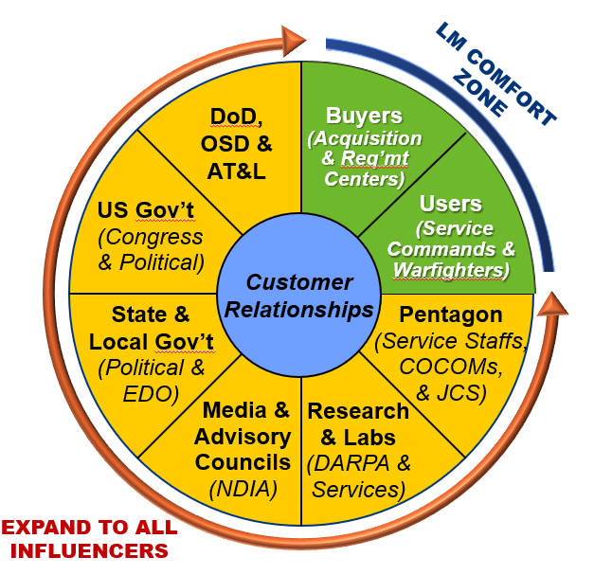
Who Determines “Value”?
Value is Often Viewed as the Performance-to-Cost Ratio
Cost is Hard to Estimate but Objectively Based
Performance Estimates are both More Complex and More Subjective
DoD Programs have Multiple Stakeholders --Seriously Complicating Who Defines “Value”
Achieving “Affordability” Requires Aligning Customer Value & Cost
Influence of Customer Segments Change over Life of Program
Notes:
For Lockheed Martin QCV is complicated by the fact that there is never one customer to satisfy. Worse yet, it is frequently complicated by the fact that engineering teams, project managers and even business leaders lose sight of the fact that there is more than one customer to satisfy.
This image of the multi-headed hydra illustrates the problem. Let’s consider an easy example. We won a DARPA contract to pursue a Reconnaissance, Surveillance and Target Acquisition Vehicle (RSTV) for the Marine Corps. To move from Phase I (basically view graphs and studies) to Phase 2, we needed to satisfy DARPA. But to eventually move from Phase 2 to ESD and Production we would need to satisfy not only Marine Systems Command, but also the generals in the Fleet Marine Force. DARPA wanted to demonstrate a bunch of nifty technologies in batteries, power management, sensors and stealth. The FMF was looking for a V-22 compatible vehicle that would be the basis for a fleet of “jeeps” and had little interest in the sensors or stealth. Additionally they were rather risk adverse about the hybrid electric propulsion system. Lockheed Martin managers decided to please DARPA, won the Phase 2 contract and built a prototype. It’s still parked on our back lot. The platform could not generate support from a customer that would champion it through the rest of the procurement process (the big body of the hydra) because it had too much design inertia from the DARPA effort.
The lesson is not to ignore DARPA but to identify all the stakeholders early in the program and then capture the quantified customer values for each. This information can then be used by program and business managers to shape our capture plans and our stakeholder management plans.
But different customer communities can operate in other ways to complicate the QCV process…

Slide 20

Program Cost Evaluation Types
Lowest Price, Technically Acceptable
Best Value
Trade Offs
What is the least I can spend for this capability?
Can I get more capability for a little more money (~15%)?
LPTA
BV
Relative Frequency of LM Programs
Lowest Cost,
Trade Away
Performance
Lowest Price,
Technically Acceptable
Subjective Trade Off
Value Adjusted Total Evaluated Price
Cost >> Technical
Cost > Technical
Technical > Cost
Technical >> Cost
Which bucket does your program fall into?

Slide 21
Cost Evaluation Myths
“Best Value means cost doesn’t matter, only performance”
  Maximum of 10% to 20% premium available for additional capability
  To claim additional value, feature must tie directly to an objective capability
  Performance margin is only worth ~5%
“LPTA means that the customer doesn’t want a quality product”
  False, but higher performance does not translate to more customer capability or value
“Lockheed Martin shouldn’t bid LPTA”
  There is lots of good LPTA work out there (production, replacement, services, etc)
% of Compliant Competitor Price
Objective Requirements (15%)
Margin (+/-5%)
Threshold Requirements (100%)
New Challenge:
Maximizing Delivered Capability within Cost Constraints

Slide 22
Knowledge Check
What is Affordability?
  IT DEPENDS. Generally when Value > Cost from a Customer Perspective
  i.e. “Is it worth what I am paying given competing priorities & alternative solutions”
Life Cycle Cost is made up of which four major cost categories?
  Research, Development, Test, & Evaluation (RDT&E); Procurement;
  Operations & Support (O&S); Disposal
  At the start of Production, what percentage of the product’s life cycle is typically set?
  >90%
In which phase are the highest annual taxpayer expenditures?
  Full Rate Production
Which phase (for most types of systems) generates the largest total cost?
  Operations & Support
What are the two basic types of competitive evaluation methods?
  Best Value
  Lowest Price, Technically Acceptable (LPTA)

Slide 23
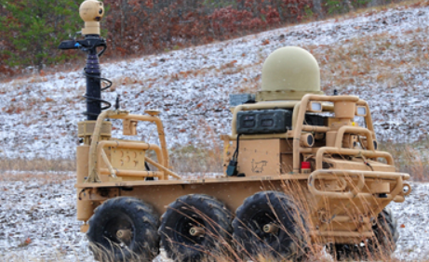
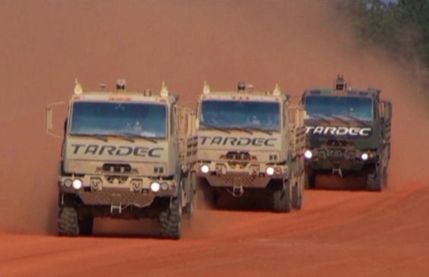
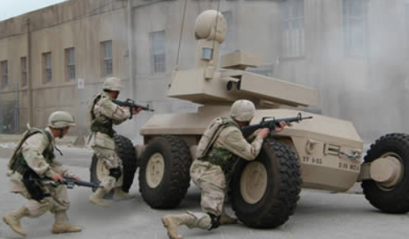
Affordability Exercise
“How is this relevant?”
Let’s Build an Unmanned
Ground Vehicle!

Slide 24
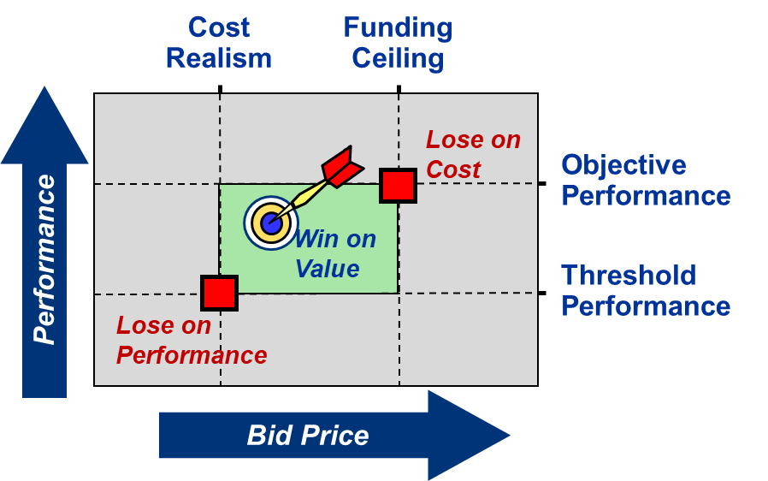
Value Optimization and Design to Cost
“How do we do it?”

Slide 25
Key Takeaways from LM Wins / Losses
Cost
Realism
Funding
Ceiling
Winners Best Understand & Deliver Customer Value
Customers are Awarding Innovative “Best Value” Threshold-Solutions that have…
  Incremental Growth Paths
  Detailed Plan & Schedule
  Good Past Performance
Lose on
Cost
Objective
Performance
Performance
Win on
Value
Threshold
Performance
Lose on
Performance
Bid Price
Key Winning Attributes:
  Start Early, Shape-the-Game
  Embrace Customer Cost Models
  Winnable & Executable Deal
  ‘Timely’ Position To Win Goals
  “Design In” Customer Value & Affordability
Takeaways from Losses
Didn’t Ask
Didn’t Listen
Focused on our Solution
Late Position To Win
No Design to Cost
Winners Make it Happen, Losers Let it Happen

Slide 26
What is Design To Cost (DTC)?
A Process for Aligning System Design with Cost Targets
  Minimizing cost while achieving required performance
  Tracking costs & performing cost/performance tradeoffs
  Often target is a Unit Cost, but can also be Development & O&S costs
Purpose:
  (1) Improve Situational Awareness of Costs During Development
  (2) Focus on Maximizing Value of Our Solutions to Customer
  (3) Promote Innovation to Maximize Performance within Constraints
Goal: Technical Solutions Aligned to Cost Requirements Resulting in Increased Customer Value & Business Success
Unaffordable Systems Do Not Make It to Production or the Warfighter

Slide 27

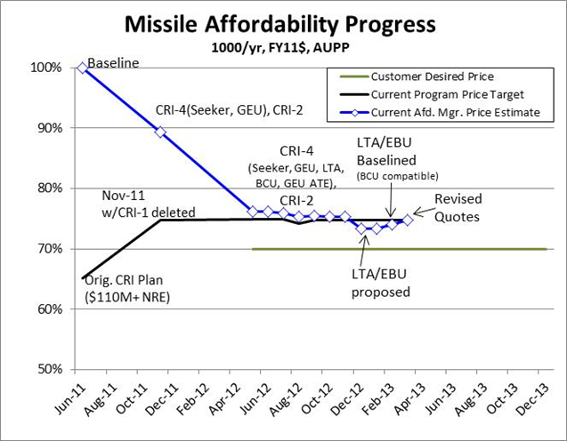


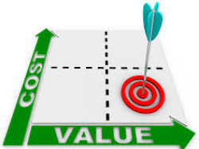

What is Design To Cost?
Lockheed Martin’s process for managing Cost as a Requirement
Performance
$
Balance
Plan
Monitor & Control
Focus on
Customer Value
Innovate
Win
Unaffordable Systems Do Not Make It to Production or the Warfighter

Slide 28
LM Design To Cost Process
S-M-A-R-T
$
Affordability Lead
Establish Initial
Program Cost & Technical Targets
Allocate Cost Targets
to High-Level
Program Elements
Develop a
Cost Estimation Framework
Business Development
Program Manager
Identify Candidate Architectures & Technology Profiles
Evaluate Cost/ Performance/Risk vs Targets & Select
Collaboratively Mature Solution & Work
Towards Target
Technical Lead
Program Manager
& Technical Lead
TechOps, ProdOps, BizOps, GSCO, PM, BD
Collaboration among Functions Key to Designing for Affordability

Slide 29
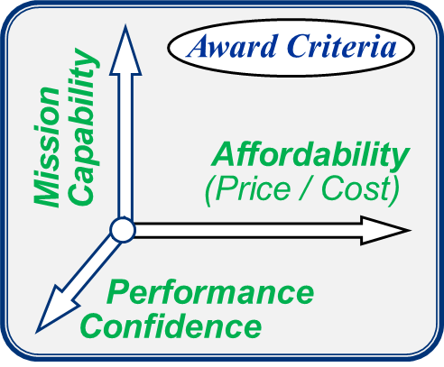
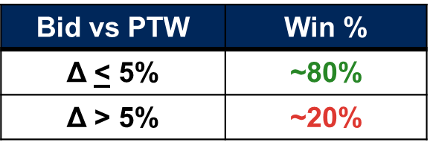
Targets & Positioning-To-Win (PTW)
Establish Targets
Targets & Positioning-To-Win (PTW)
Market-Driven Estimates of What We Must Bid to Win
  Non-Price Goals: Proposal Color, Risk, & Past Performance Ratings
  Price Goals: Bid Price, Most Probable Cost (MPC) &
  Total Evaluated Price
Based on:
  Anticipated Key Competitors’ Bid Strategies
  Customer’s Award Criteria
  Observed Customer Behavior
Based on ~50 LM-wide $100M+ competitive proposals from 2013-2014
Cost Requirements Are NOT Based On Our Preferred Solution

Slide 30
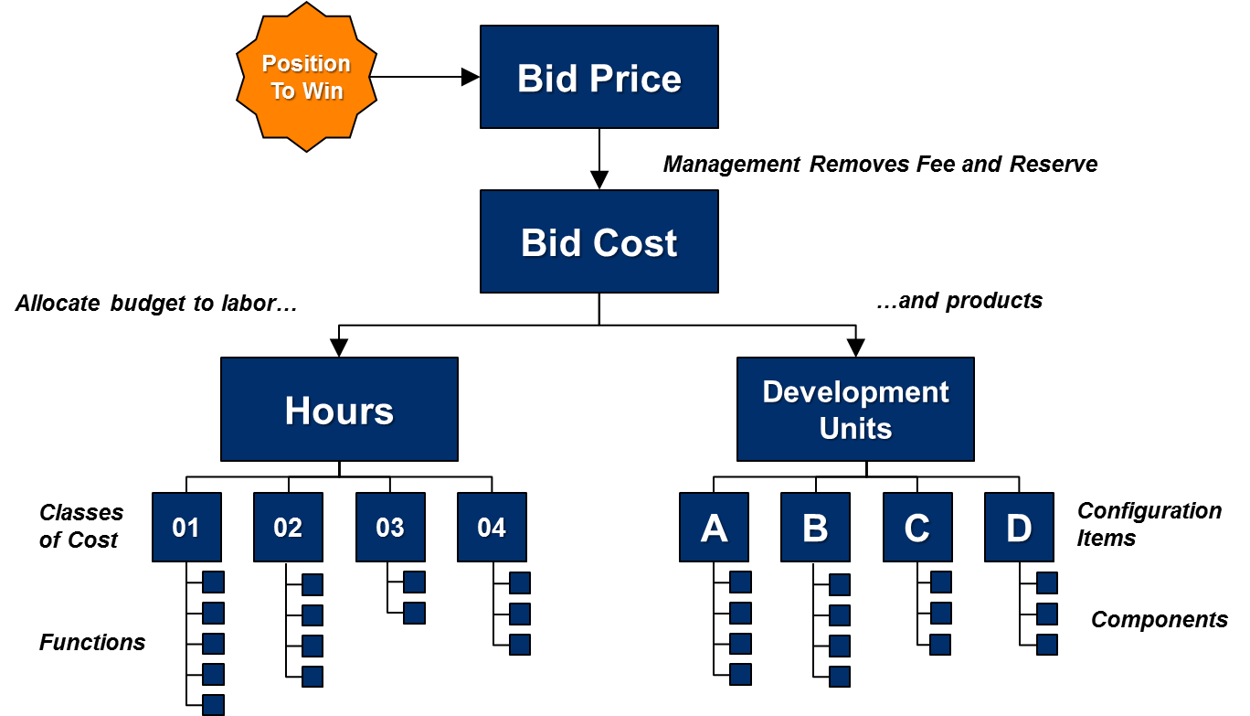
Affordability Targets
Specific
Measureable
Achievable
Relevant
Time-Bound
Assign a goal cost with margin!
(e.g. If Bid Cost was $100K, allocate $85K)
Four Key Questions:
1. What is/are your target(s)?
2. How do you know it’s still good?
3. Where is estimate vs target?
4. What are you doing about it?
Targets Must be Based on Leading Indicators & Relevant to Business

Slide 31
Unit Cost Estimates
Engineers need to understand and communicate using the DoD defined Cost Elements:
  Document Ground Rules and Assumptions
  Identify Scope
  Understand which Cost Target(s) Are Tracked by the Customer
Avg Unit
Procurement Cost
Wpn Sys Cost
+ Initial Spares
+ Initial
Repair Parts
Acquisition
Cost
AUPC
+ MILCON
+ RDT&E
Life Cycle
Cost
Acq Cost
+ Operations
& Support
+ Disposal
Unit Mfg Cost
Materials
Mfg Labor
IAT&C
Flyaway Cost
DTUPC
+ Specl Tooling
+ Prog Mgmt/SE
+ Eng Changes
+ Transportation
+ Sys Tst & Eval
+ Warranty
Wpn Sys Cost
Flyaway Cost
+ Data Pkgs
+ Spt Equip
+ Training
+ Contract Svc
+ Op Site Actvty
+ Industrial Fac.
Unit Mfg Cost
Materials
Mfg Labor
IA&T
DTUPC
UMC
+ Recurring Eng
+ Quality Cntl
+ Sust. Tooling
NRE
tracked
here
Always Apply Rates and Factors (e.g. Materials Burdens, G&A, Fee)
Notes:
This chart was taken from the Army Cost Manual.

Slide 32
Cost Estimating Approaches
Analogy
Parametric
Bottom’s Up
Actual Costs
BOEs
ACE-IT
“Similar-To”
A
Development
B
(Program Initiation)
C
Technology
Materiel
Technological Maturity
Engineering and Manufacturing
Production and Deployment
Operations and
Solution
and Integration Risk
Development
Support
Analysis
Assessment
FRP
Competitive
PDR
CDR
Decision
Prototyping
Review
Required Accuracy & Precision for Estimates
+/- 5%
+/- 1%
+/- 15%
+/- 10%
A “Good” Estimate Early is Better than a “Perfect” Estimate Too Late
Notes:
Analogy
Compare to and existing item/system with real cost.
Estimates are completely subjective.
Parametric
Cost Estimating Relationships (CERs) are developed and compared to historical information.
Based on: Functions; Industry; Weight
Strengths:
Beneficial when detailed historical cost databases are available.
Only really useful early in the lifecycle.
Allows for a quick analysis.
Very little inputs needed.
Weaknesses:
Cannot handle changes easily.
Provides little insight at the subsystem level.
The model provides “program office” estimate of the cost.
The fidelity of the model is very low.
Grassroots
Detailed model based on a maturing design.
Some call this “activity-based” modeling.
Based on: Quantity; Learning Curves; Time; Lot sizes; Initial Cost (T1); Type of item
Strengths
Will provide insights into manufacturing trade-space.
Identifies capacity, resource and time constraints.
Can utilize new manufacturing technologies.
A well-developed model is modular and can be used with several layers of detail (including subcontractors).
Weaknesses
Detailed input data not available early in the lifecycle.
Building and maintaining can be time consuming.
Actual Cost:
Expenses incurred producing the system.

Slide 33
Parametric Cost Estimation
Statistical Estimate of Material & Labor Cost
Based on Extensive Database of Relevant Components
Calibrated to Each Site’s Efficiency via Historical Data
Complexity
Moving Parts
Machining/ Processing
INPUTS
OUTPUTS
Maturity
Predictability
Design Team Knowledge
Estimates
Per Unit Cost
Development Cost
Development Schedule
Cost Risk
Schedule Risk
Tooling & Test Equipment Cost
f(x₁,x₂,…x_{n})
Material Type
Structure
Electronics
Optics
Ordnance
Weight

Slide 34
Kano Requirements Analysis
Derived from http://www.c2c-solutions.com
The Kano Diagram
EXCITER: DISCRIMINATOR
Customer
Satisfied
System characteristics that are unexpected, but add capabilities that are highly desirable
KNOWN REQUIREMENTS:
Those characteristics that the customer actively seeks to achieve the required capability
Attractive/
Exciter
One-Dimensional/
Satisfier
Product
Dysfunctional
Product Fully
Functional
Basic/
Dissatisfier
BASIC: EXPECTED:
Characteristics that the customer fully expects. Show stoppers even if not articulated.
Customer
Dissatisfied
Not all requirements are created equal; They must be prioritized based on value

Slide 35
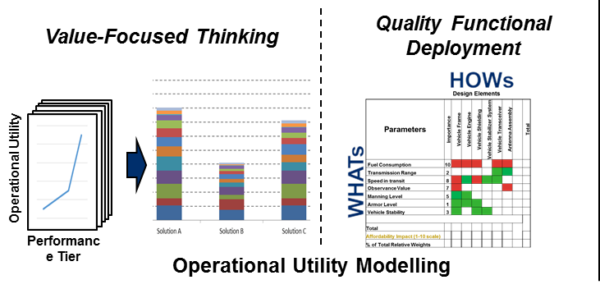
Capability & Mission Utility Modeling
Performance Tiers
Concept Development Phase
Design Phase
Fast, high-level analysis
Time-intensive, detail required, high level of granularity
Assessment of Mission Effectiveness & Suitability, not just “Performance”
Lockheed Martin Proprietary Information

Slide 36
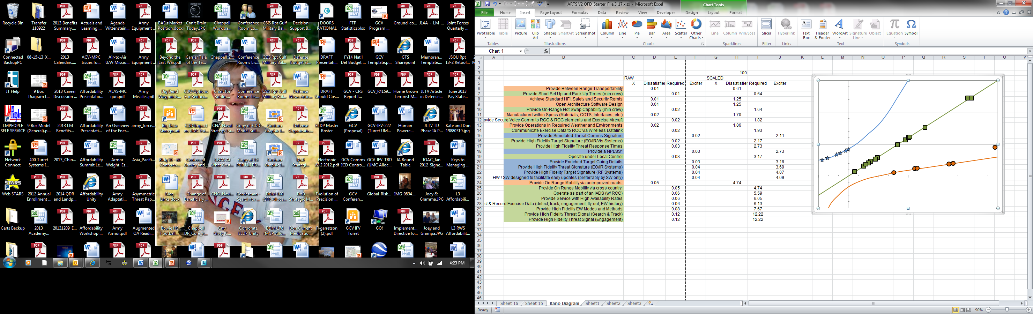
Kano Diagram Example
Interpretation of the QFD sorted the concepts into categories:
  Exciters (Discriminators)
  Satisfiers (Asked for)
  Basic (Dissatisfiers)
Arcs of the Kano Diagram identify highest value functions
Notice the large gaps between the top and middle values along
each line.
RF Emissions
Customer
Satisfaction
Built In
Growth
RCC Functions
EW Modes
Mobility
Cross Country
Mobility
Secondary Roads
Hi Availability
System
Functionality
Adding a “cut line” to demark this gap, provides insight into what design attributes must be retained and which are tradeable.
Identifies where to focus during development to optimize value

Slide 37
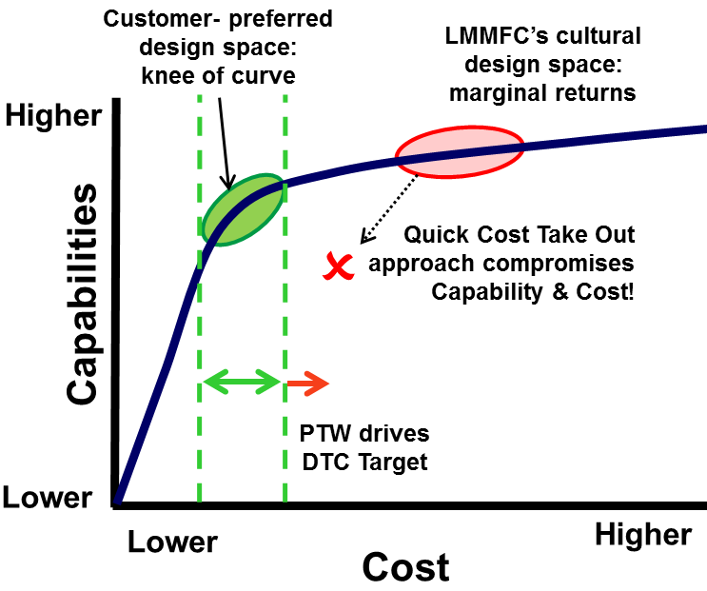
Cost vs Capability Analysis
The optimal frontier is a mathematical ideal solution. It always has this marginal returns shape. This helps by:
Visualizing the trade space
Eases the calculation of the estimated optimal frontier
Helps avoid the “no win” regions
Similarly relates with other dimensions such as risk, weight and schedule
Augustine’s Law #15: “The last 10% of performance generates 1/3 of the cost & 2/3 of the problems”
Successful offering must meet both cost and performance targets

Slide 38
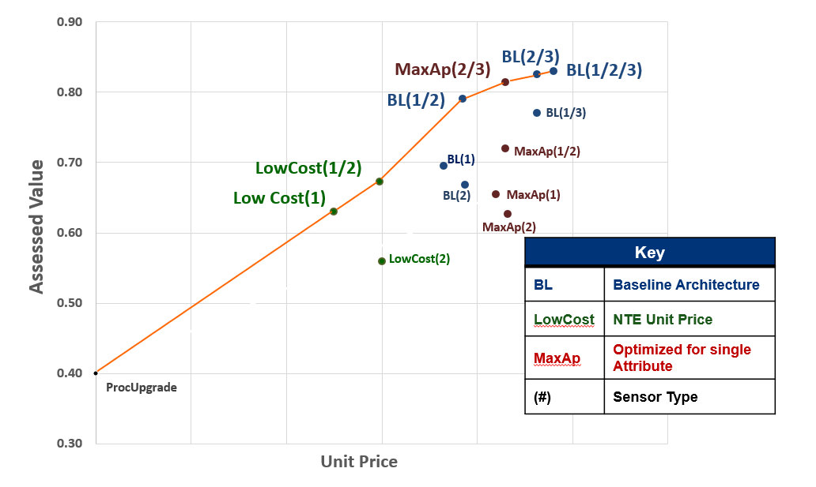
Cost Capability Analysis
Facilitates Customer Collaboration on Value & Cost

Slide 39
Cost as an Independent Variable
Vehicle System Configurations Performance as a f (AUPC)
0.80
0.70
0.60
Sensors
Operational Value
C4I
0.50
Survivability
Vehicle
0.40
0.30
$3.0M
$3.5M
$4.0M
$4.5M
$5.0M
$5.5M
$6.0M
Cost Brackets
Combinatorial Trades Determine Best Value for Each Cost Tier

Slide 40



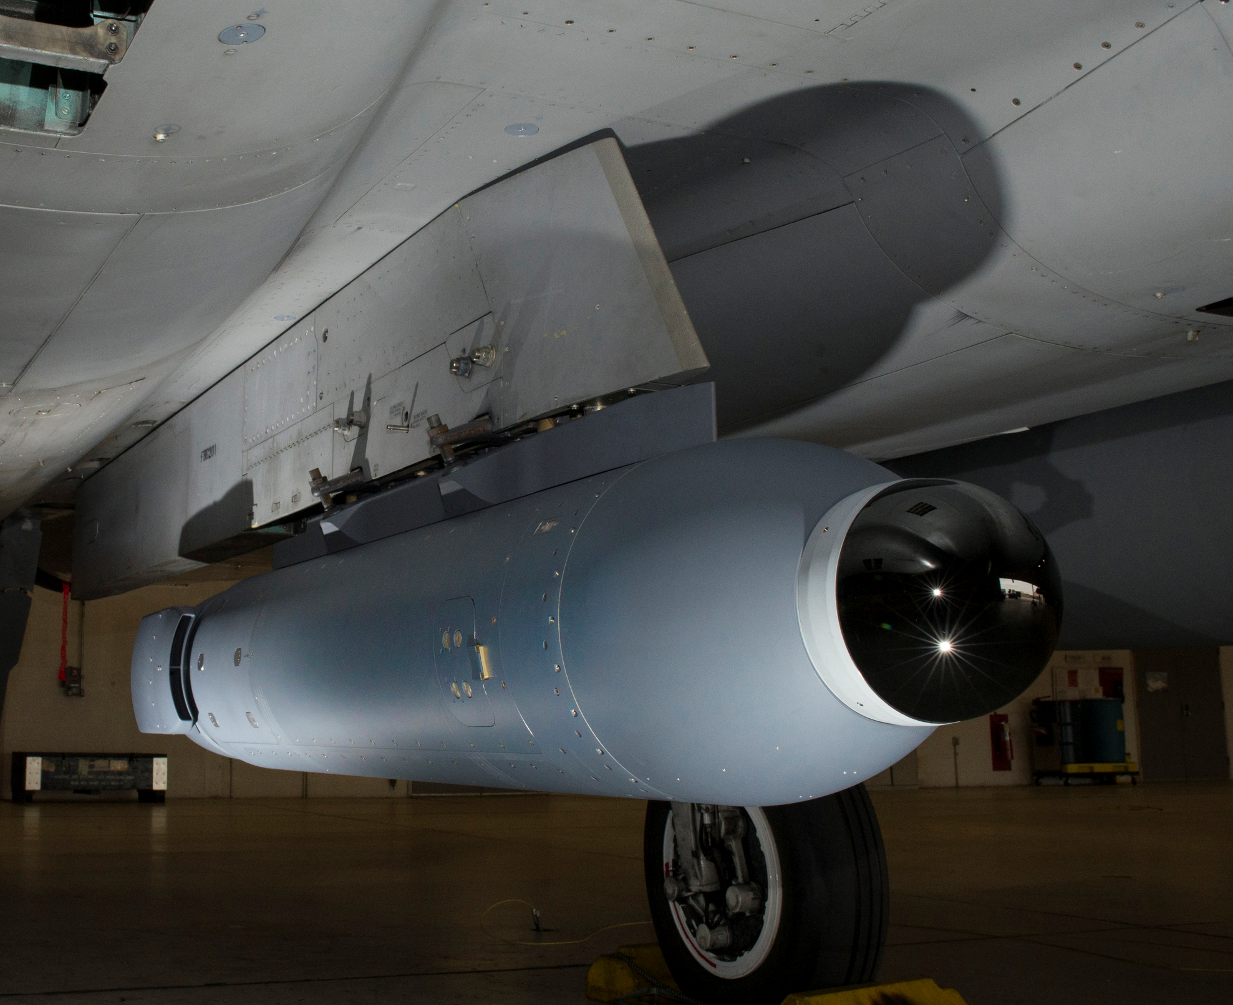


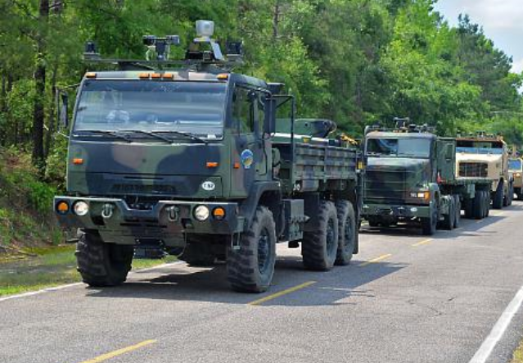
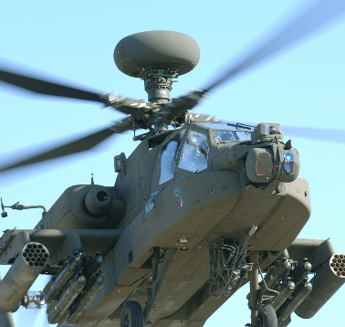
Rapid Collaborative Development
Material Acquisition
Using Data
to Design Solutions
that are:
Cost Competitive
High-Value
Sourceable
Producible
Sustainable
Executive Initiation
& Support
Manufacture
Point of Departure Architecture
Precision Fires
Legion Pod
Design
Support
Capture
IRAD Execution
Autonomy Kits
MTADS
Understanding the Big Picture Early To Start Development in the Right Place

Slide 41
Rapid Collaborative Development (RCD)
Rapid Collaborative Development (RCD)
Pursuit Baseline
System Trades Informed by Cost
Value
Position To Win
Initial Cost Models & Assessments
Technology Roadmaps
Mission Analysis
Logistics & Sustainment
Mission Requirements
Initial System Concepts
Business Strategy
System Cost
Models
System Technical Models
Technical
Architecture
Where we need to be
Where we are
Organization Structure
Subcontracting & Teaming
Manufacturing
Data-Driven Architecture Selection
System Cost
Model
System Technical Model
Pair of Linked Models
MFC Standard Tools
Parametric Cost
Estimation: TRUE Planning
System Architecture:
Rhapsody
Technical & Cost Baselines
Development Phase
Output: High-Customer-Value Architecture with Balanced Technical & Cost Factors

Slide 42
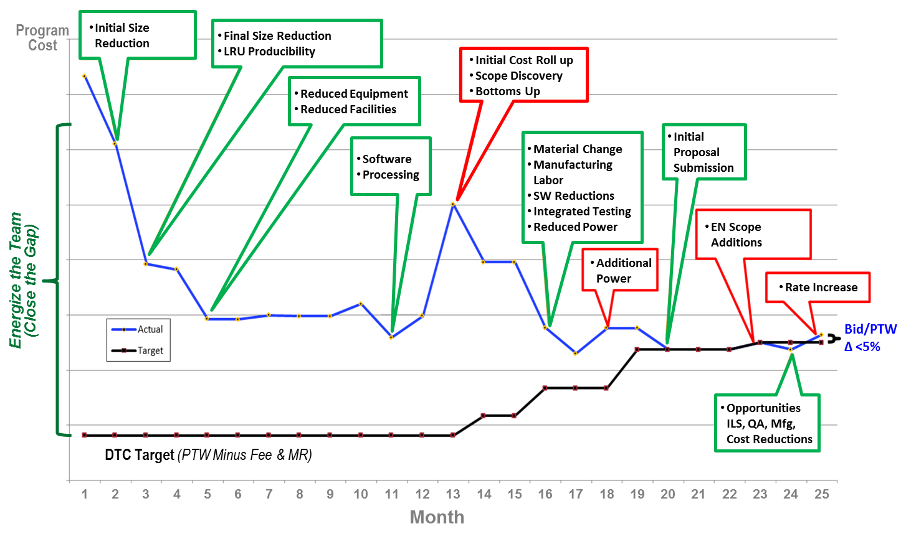
Design To Cost in Action
Design To Cost in Action
Increased Customer Value
Approach Proven to Increase Probability of Win on Major Programs
Notes:
42

Slide 43
Knowledge Check
What is the primary business benefit of the Design To Cost (DTC) methodology?
  Improved Probability of Win through Balancing of Performance & Cost
What are the four cost estimation methods that we identified?
  Analogy/Similar-To | Parametric | Bottom’s Up | Actuals
On a Cost vs Performance Curve, where is the Best Value solution often found?
  “The Knee of the curve” (aka The Point of Diminishing Returns)

Slide 44
Review & Conclusion
“What Did We Learn &
What Do I Do Next?”

Slide 45
What Did We Learn?
Improving Affordability is a Cultural Imperative
  The Customer is Serious
  Missiles and Fire Control is Committed
  Designing Value in Initially is Preferable to Cost Take-out Later
  Lower cost, Less Risk, & Improved Performance per Dollar
Establishing Targets & Estimating Costs Early is Critical
  Agility More than Makes up for Uncertainty
  “Good” Estimates & Targets Early are Better than “Perfect” Data Too Late
Focus on Customer’s Primary Cost Elements
  …but keep an eye on other costs as well to ensure long-term affordability
Must Increase Focus on Delivering Affordable Solutions to Our Customers

Slide 46
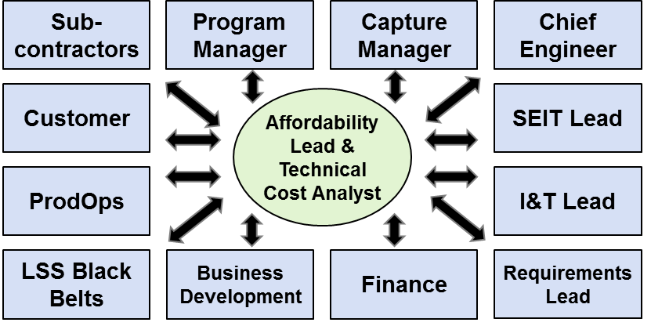

How Do I Lead?
LEARN!
Understand Your Environment
Cost Requirements
Cost/Performance Sensitivity
Environments
Margins & Tolerances
Design Reuse
Alternative Approaches
New Technology
Contribute to Affordability
on Your Programs
Ask Questions on Your Program

